Slide 1

Home Credit Default Risk
InCred

Slide 2



Meet our team
Harsha Ravuri
Kartik Tokala
Prasanth Paraselli

Slide 3
Agenda
Introduction
Feature Engineering
Exploratory Data Analysis
Machine Learning
Next Steps

Slide 4

Introduction
We are trying to evaluate the Default Risk for each borrower applying for a Home Loan. This model can help Banks and other financial institutions broaden their Financial Inclusion Agenda while lowering their Credit Risk
We have utilized data from the Kaggle Competition Home Credit Default Risk for training our model
Supervised: The labels are included in the training data and the goal is to train a model to learn to predict the labels from the features
Classification: The label is a binary variable, 0 (will repay loan on time), 1 (will have difficulty repaying loan)

Slide 5

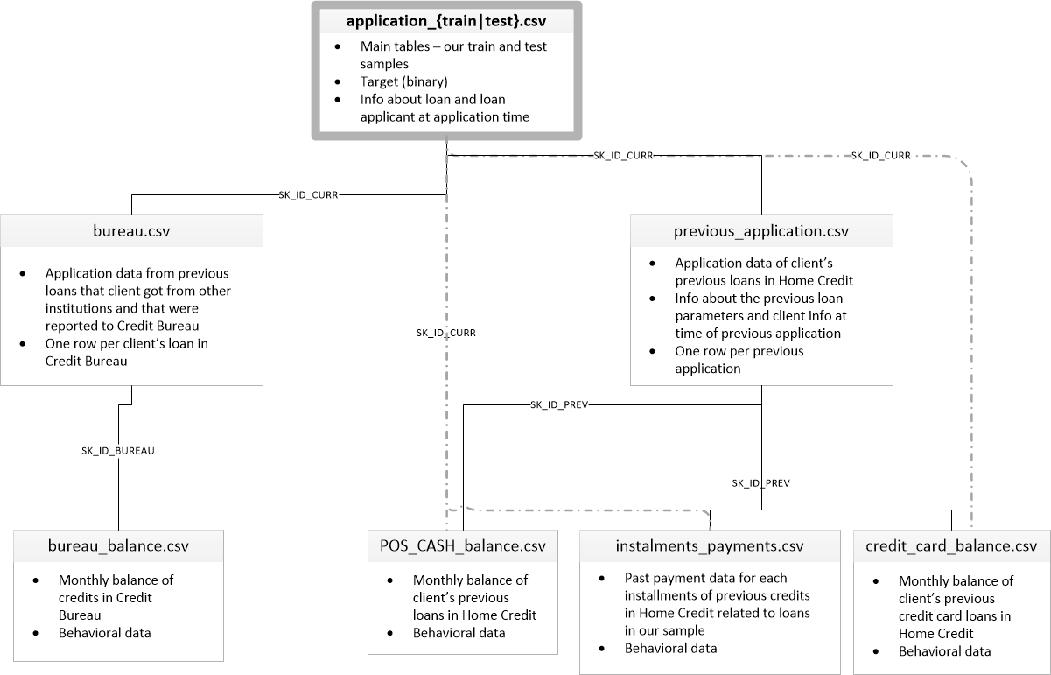
Exploratory Data Analysis

Slide 6
Data Cleaning & Encoding
This dataset is imbalanced as just 8.1% represent loans that had payment difficulties
67 of the 122 columns in the source data frame have missing values, some of these columns have nearly 69% of the data missing
Data Types
Float64 : 65
Int64 : 41
Object : 16
Most Categorical variable have a relatively small number of unique values, we have implemented Label encoding for any categorical variables having 2 unique categories and one-hot encoding for the others

Slide 7
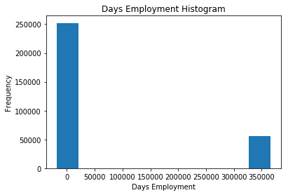
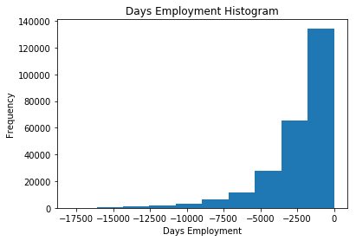
Dealing with Outliers/ Anomalies
All age Variables in this Dataset are days since start, so are expected to be negative, however we see that few applicants have a days of employment as a large positive value
We corrected this by replacing this large number with NaN

Slide 8
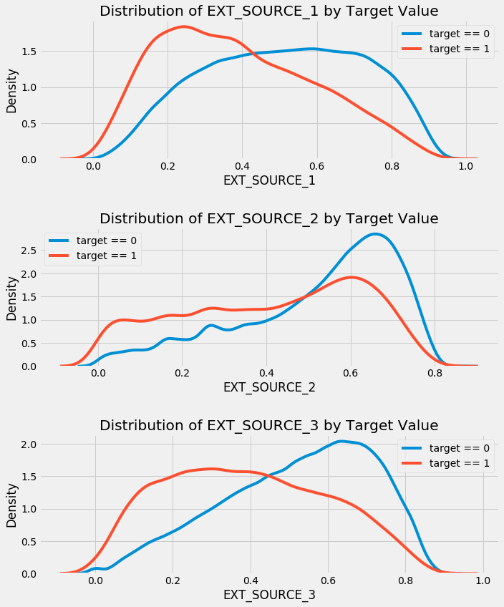
Correlations
Correlations can help represent the relevance of a feature
The 3 variables with the strongest negative correlations with the target are EXT_SOURCE_1, EXT_SOURCE_2, and EXT_SOURCE_3 which are “normalized score from external data source".
All three EXT_SOURCE features have negative correlations with the target, indicating that as the value of the EXT_SOURCE increases, the client is more likely to repay the loan

Slide 9

Feature Engineering

Slide 10
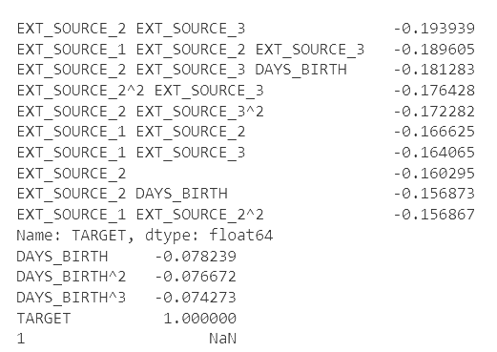
Polynomial Features
Several of the new variables have a greater (in terms of absolute magnitude) correlation with the target than the original features.
We have added these features to a copy of the training and testing data and then evaluate models with and without the features.

Slide 11
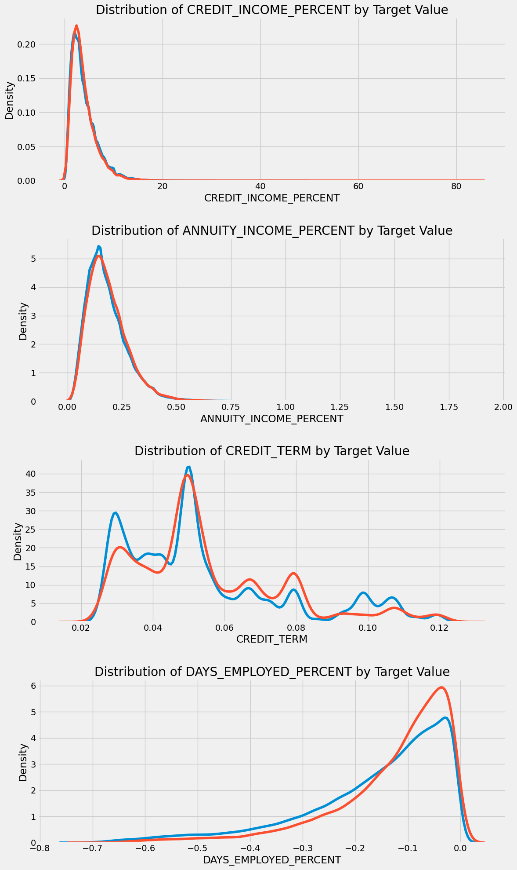
Credit Worthiness Variables
We have also created alternative variables which could help determine Credit Worthiness
Credit_Income_Percent: AMT_CREDIT/ AMT_INCOME_TOTAL
Annuity_Income_Percent: AMT_ANNUITY/ AMT_INCOME_TOTAL
Credit_Term: AMT_ANNUITY/ AMT_CREDIT
Days_Employed_Percent : DAYS_EMPLOYED/ DAYS_BIRTH

Slide 12

Machine Learning

Slide 13
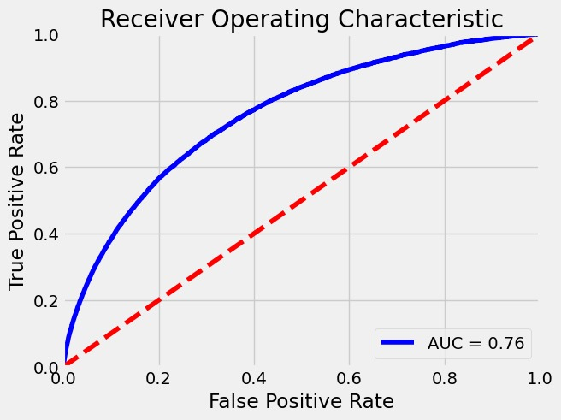
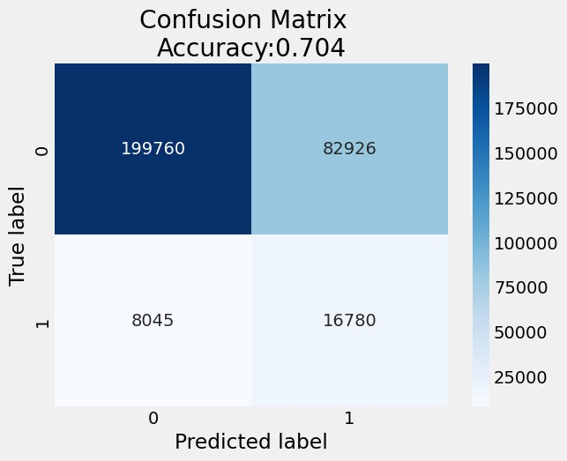
Starting with the popular LightGBM Model

Slide 14
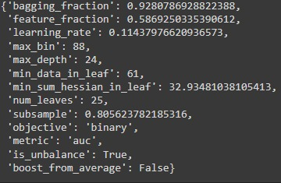
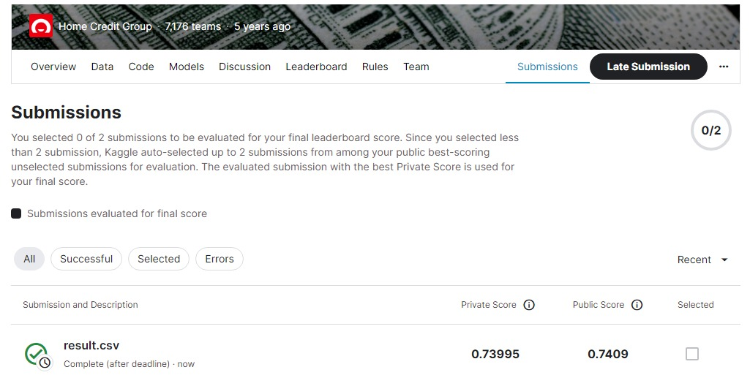
LightGBM Model

Slide 15
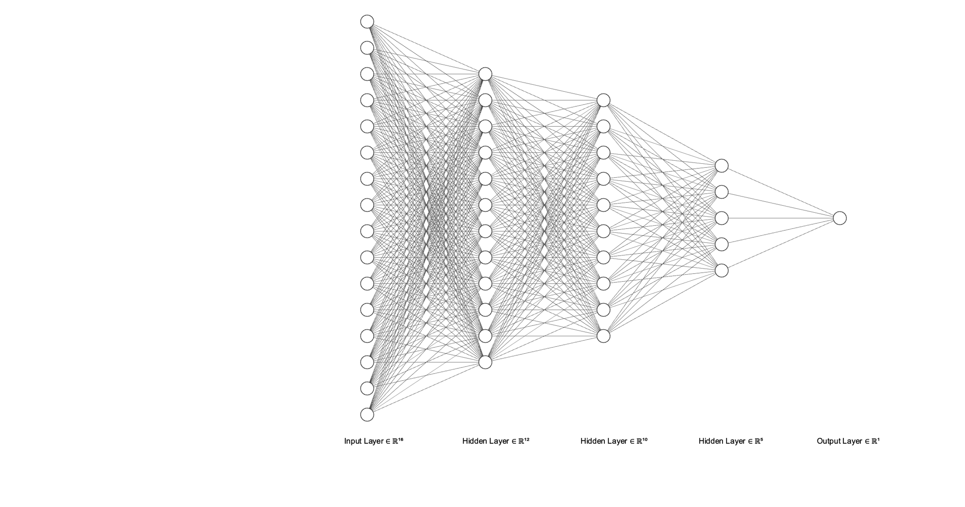
Neural Network
Processing:
Log and Sqrt transformation on columns having larger values
Missing values handled by imputation with 0
Resampling: Up-sampled the data, to make minor class make match with major class
Scaling: MinMaxScaler() on the dataset
The network architecture is as follows:
Layer 1 – Input layer (64 neurons with relu)
Layer 2 – Hidden layer(32 neurons with relu)
And BatchNormalization
Layer 3 – Hidden layer(16 neurons with relu)
And BatchNormalization
Layer 4 – Hidden layer(8 neurons with relu)
And BatchNormalization
Layer 5 – Output layer(1 neuron with sigmoid)

Slide 16

Comparison of different datasets
Dataset name | Shape | Accuracy | AUC
application_proc | (307511, 242) | 0.87 | 0.72
application_domain | (307511, 240) | 0.86 | 0.72
application_poly | (307511, 276) | 0.85 | 0.73
application_main | (356255, 257) | 0.88 | 0.76
application_proc : application_train data with OHE + Label Encoding
application_domain: application_train data with new domain features
application_poly: application_train data with polynomial features
application_main: Master dataset with a combination of processing

Slide 17
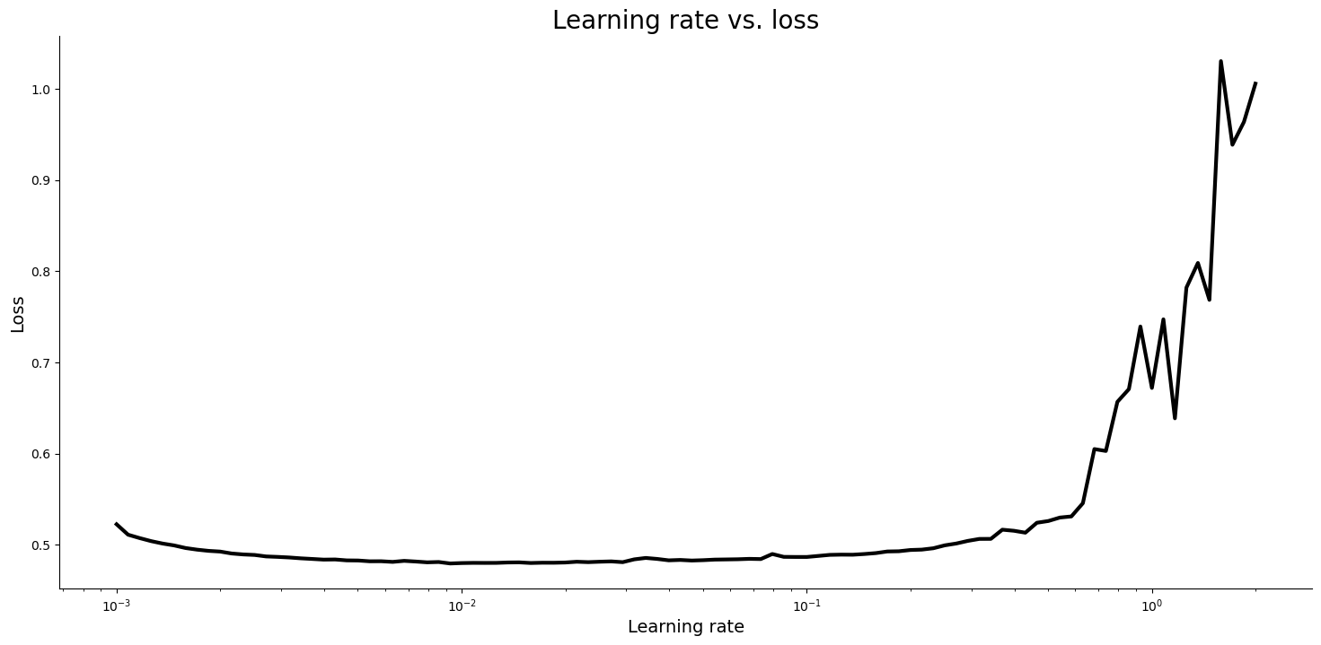
Loss vs Learning Rate
Optimal Learning Rate: 0.009 (~0.01)

Slide 18
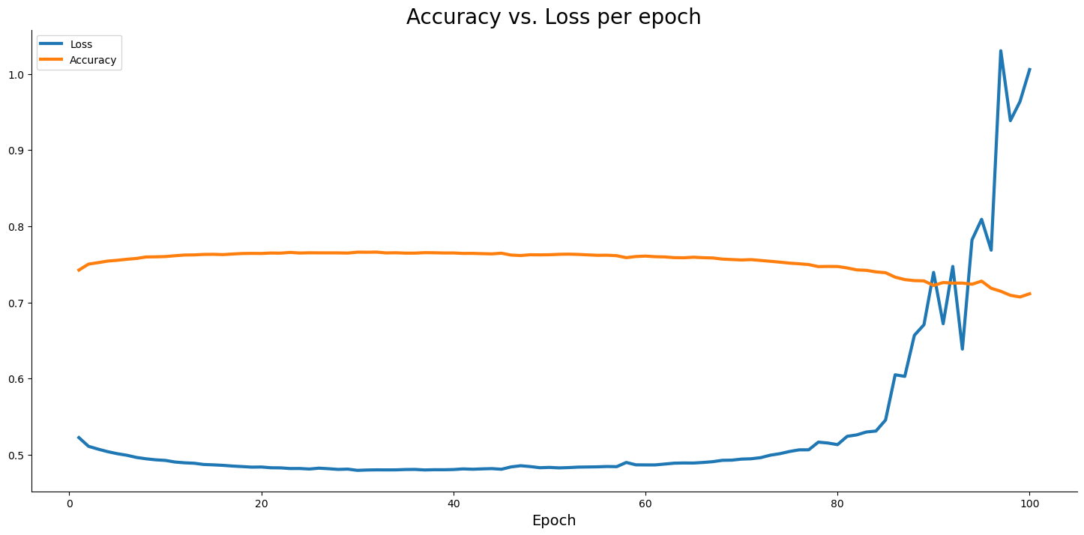
Accuracy vs Loss per epoch

Slide 19
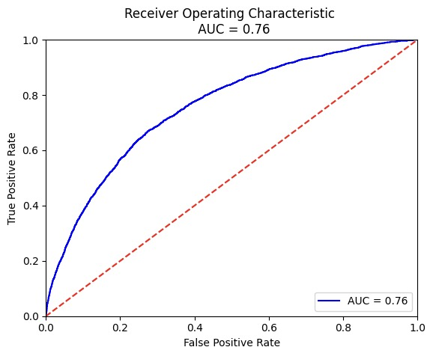
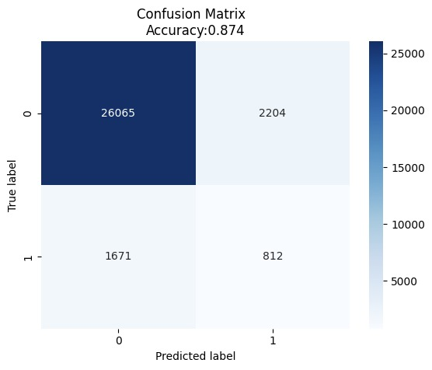
Performance of Neural Network

Slide 20
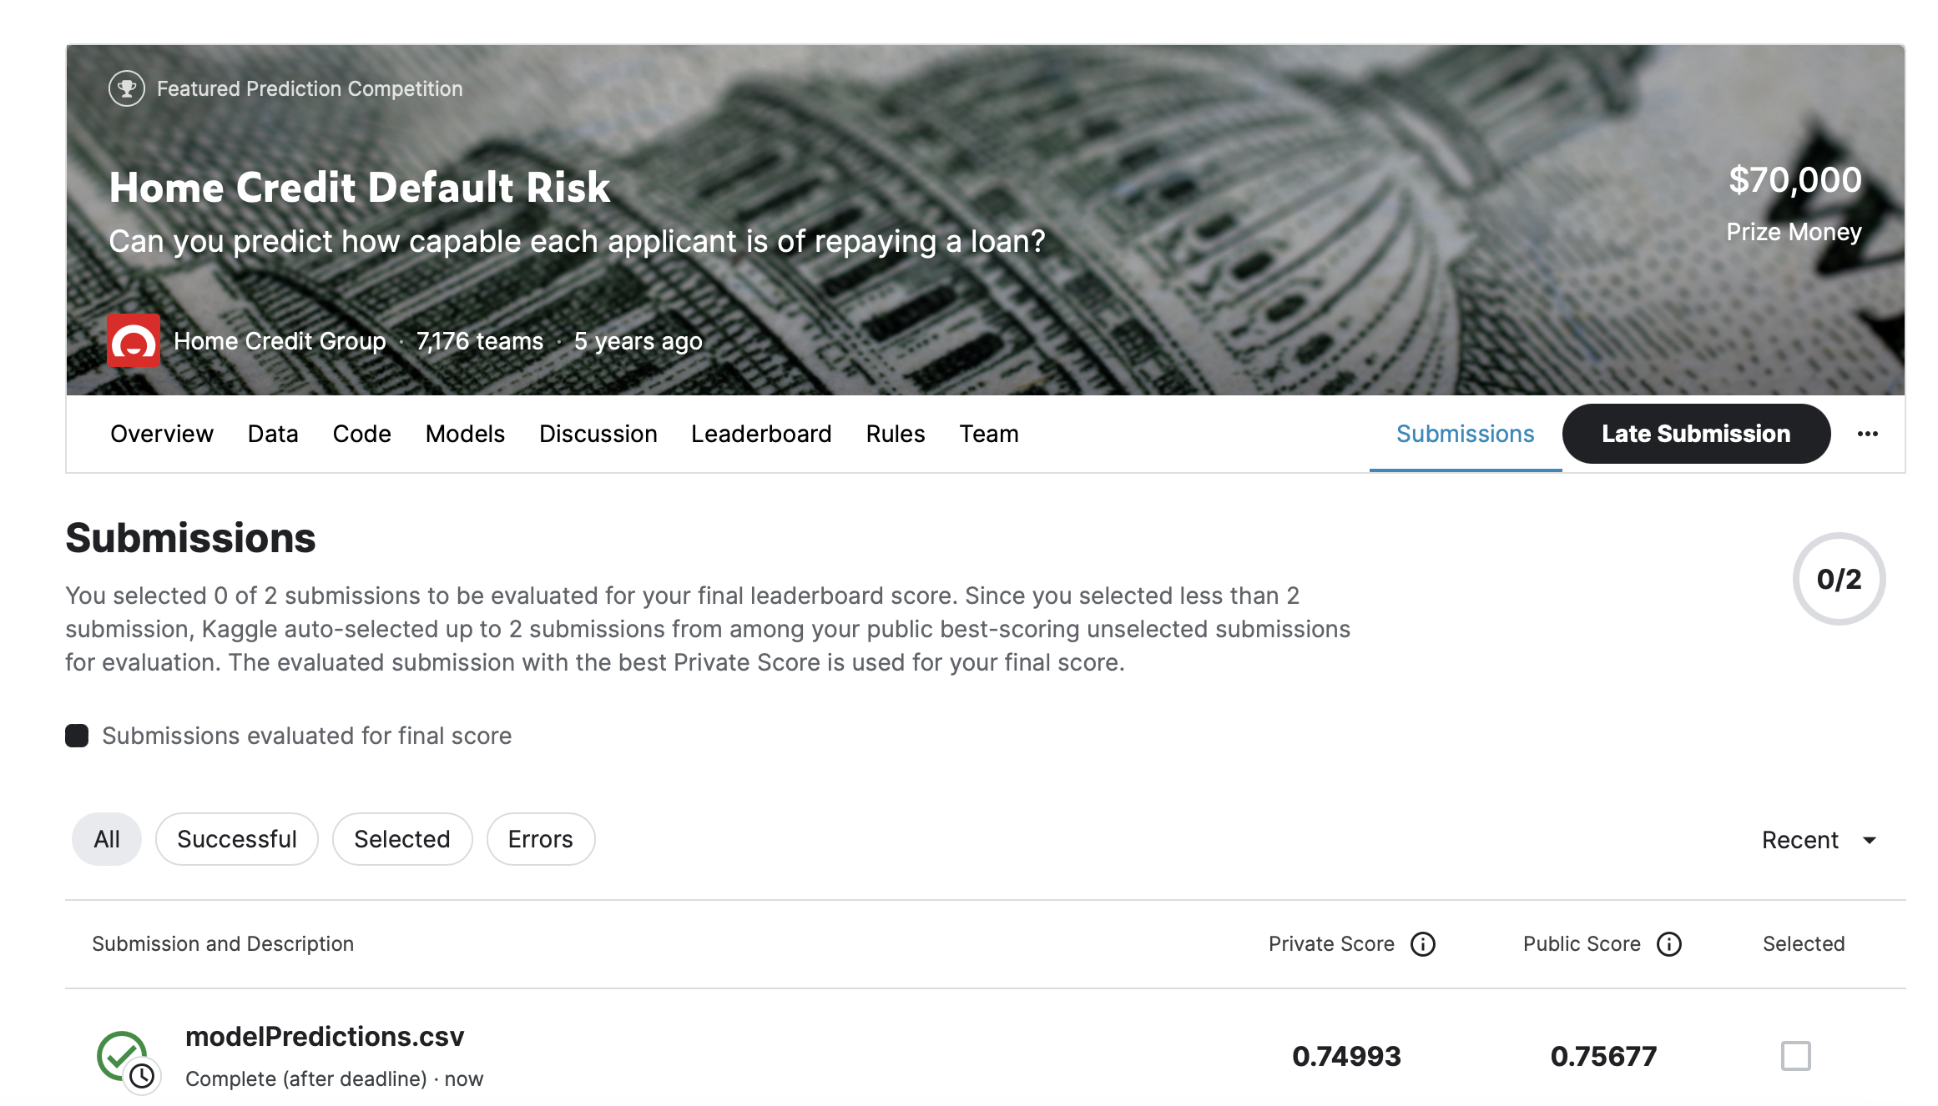
NN Model performance on Kaggle

Slide 21
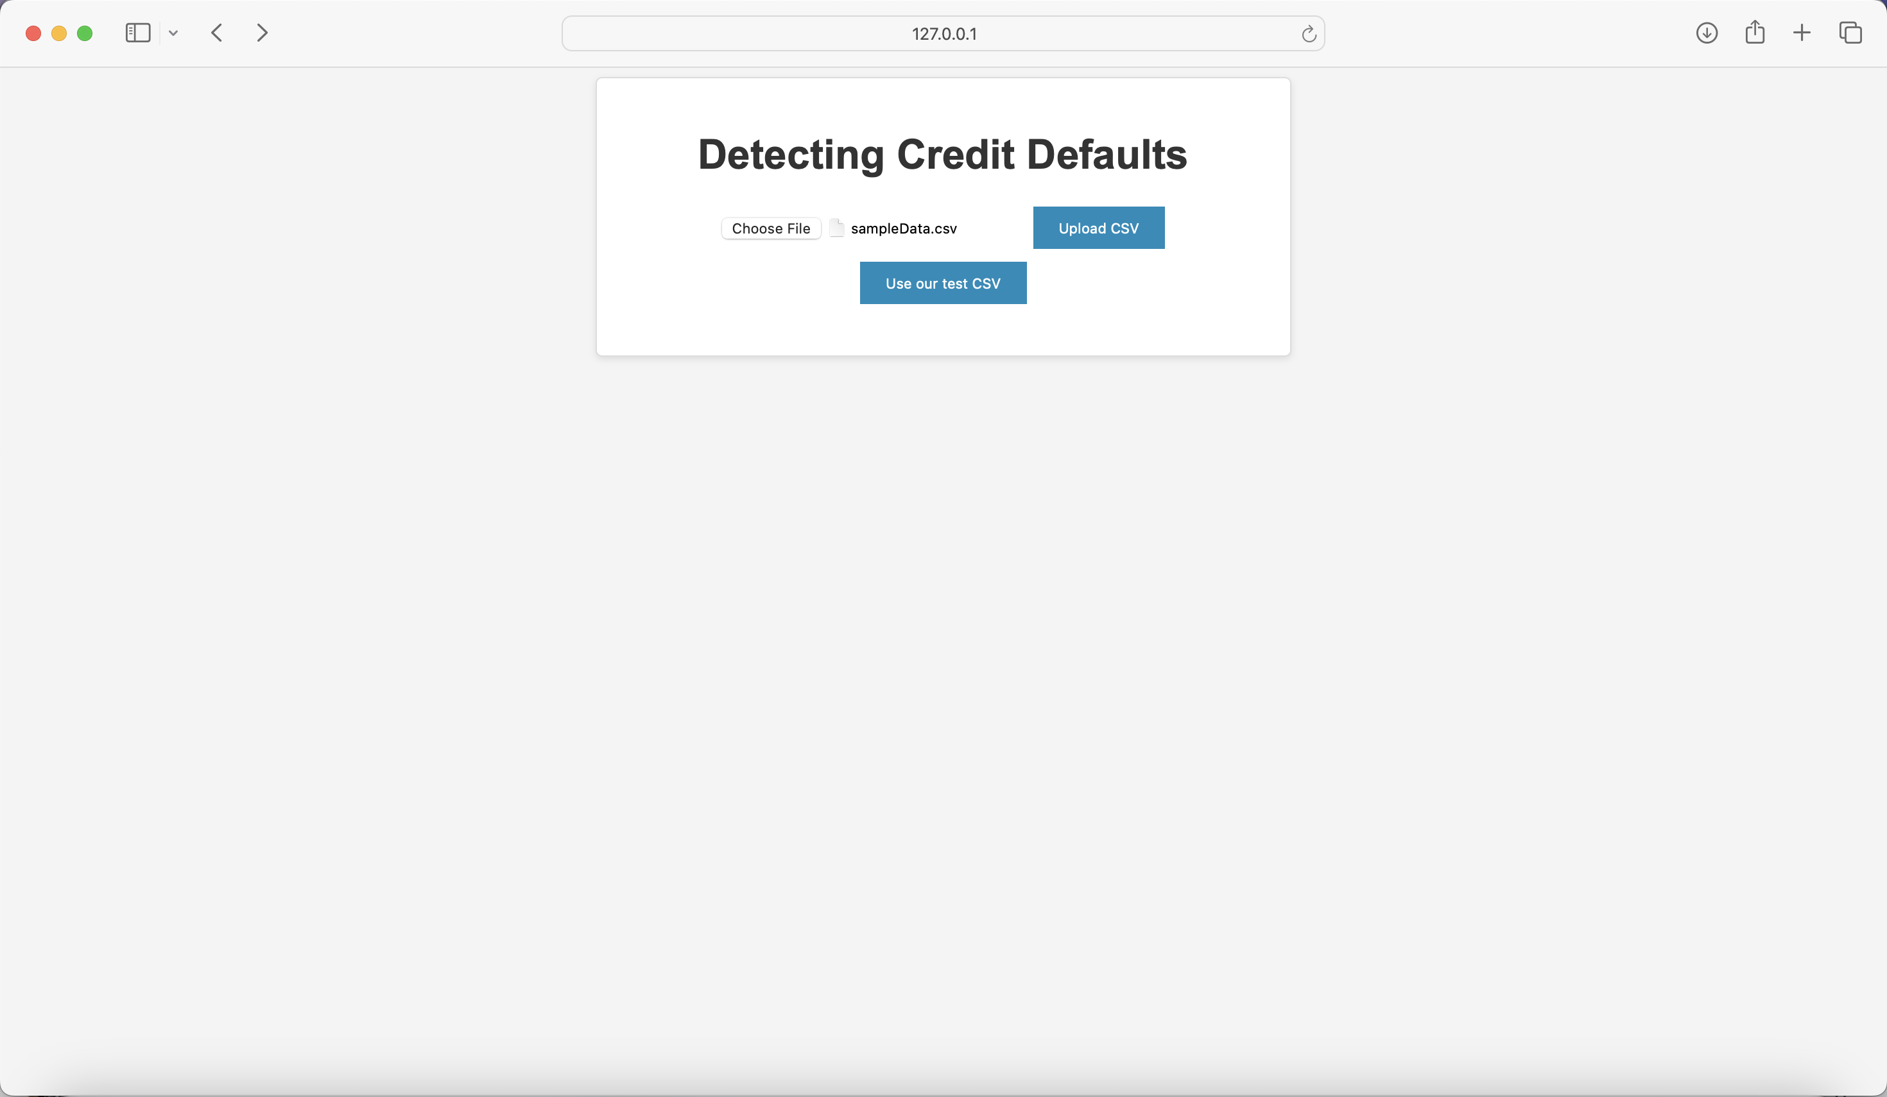
Application

Slide 22
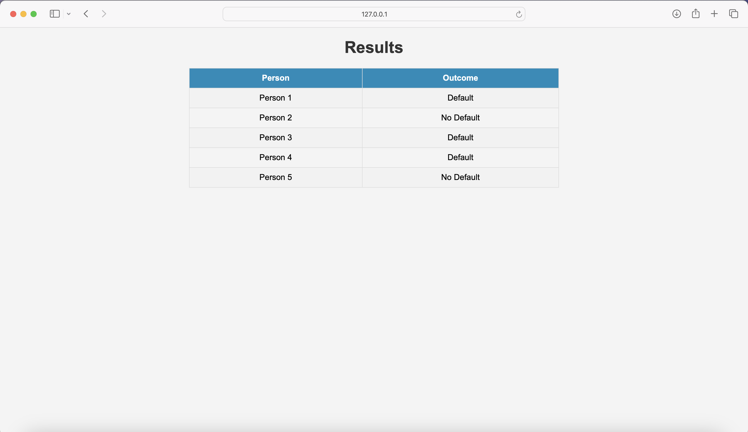
Application

Slide 23



Next Steps
Provide Credit Evaluation API
Financial Institutions can have multiple loan processing Systems, we hope to provide this service via API accessible to various systems
Continuous Training & Improvement
Continuously train the model basis newer datasets which might better represent the ground reality
Research better model architecture ( possibly using embedded NN)
Small & Medium Business Evaluation
Expand the scope of this model to be able to cater to Small & Medium Businesses which also face challenges in securing Institutional Credit

Slide 24




Thank you
Have an InCred-ible Day!!

Slide 25
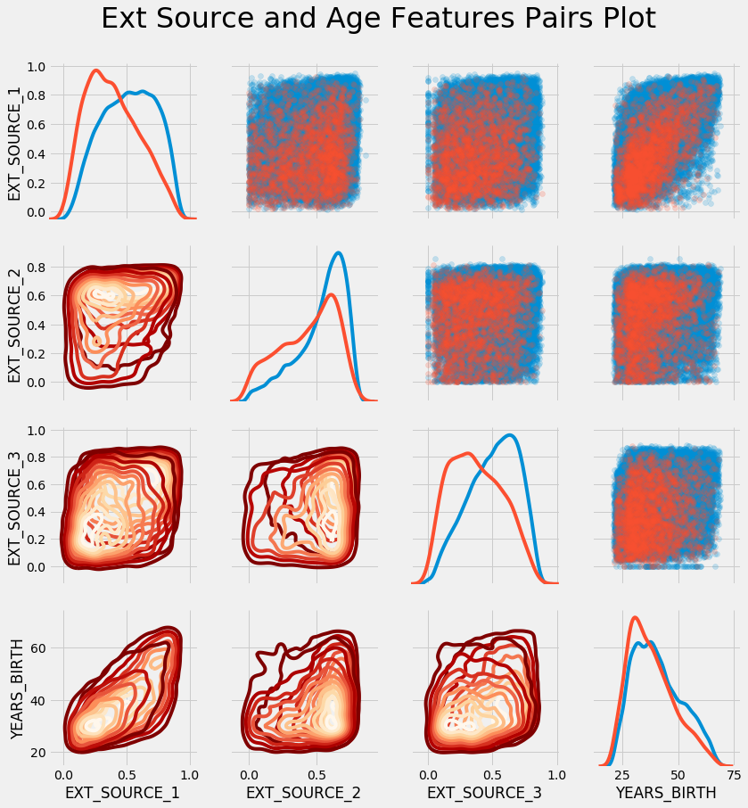
Pair Plot
The red shade indicates loans that were not repaid and the blue are loans that are paid.
We see different relationships within the data. There does appear to be a moderate positive linear relationship between the EXT_SOURCE_1 and the DAYS_BIRTH (or equivalently YEARS_BIRTH), indicating that this feature may take into account the age of the client

Slide 26
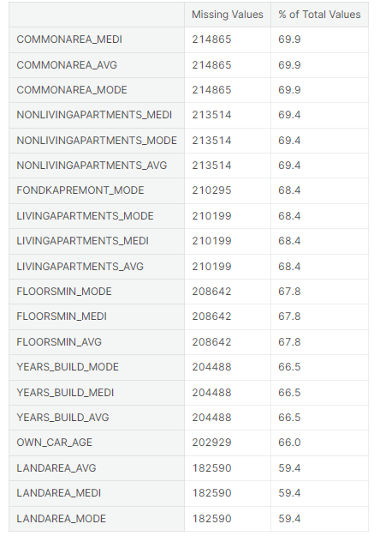
Missing Values in Data
This dataset had multiple Variables with Missing Values as well
We sued Simple Imputer and filled these values with the Median

Slide 27
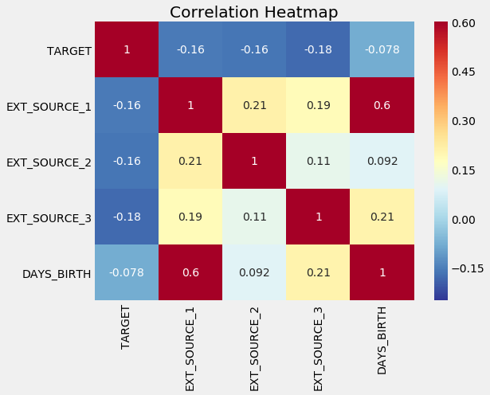
Correlation EXT_SOURCE & TARGET

Slide 28
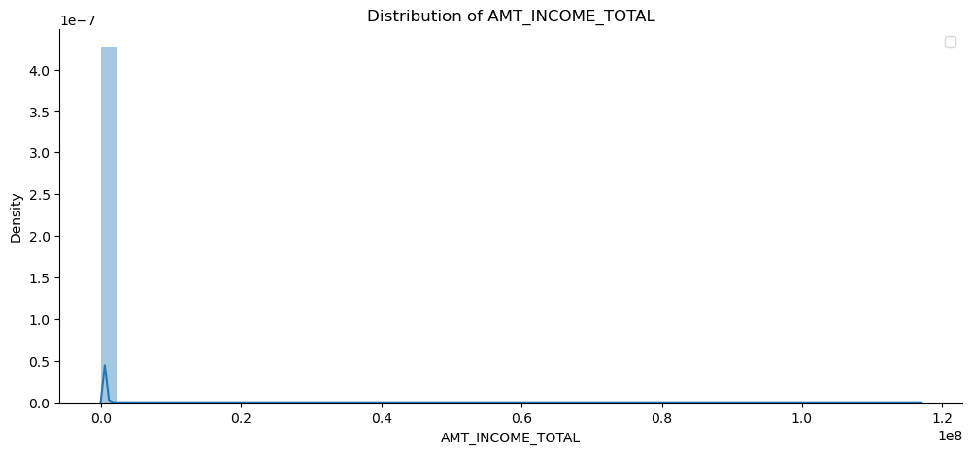
Distribution of the income of clients

Slide 29
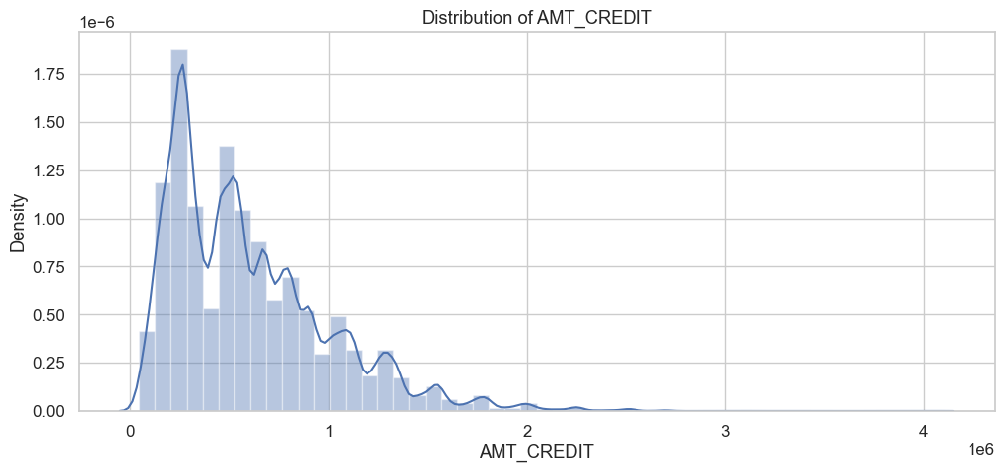
Distribution of amount of loans

Slide 30
